Slide 1
SYPHILIS IN PREGNANCY

Slide 2
Overview
Syphilis is a preventable & curable disease
15% of antenatal women have syphilis
Syphilis causes 1out of 10 stillbirths
Testing of antenatal care is widely available
Policy recommended treatment is being followed by health providers

Slide 3
Problem Statement
Syphilis treatment, compliance, and partner tracing remains a problem.

Slide 4
Objective
To document the program of providing syphilis screening and management in South Africa:
  Preparedness of program
  Effectiveness of management strategy
  Availability of drugs

Slide 5
Methodology
Reproductive Health Research Unit conducted a case study in 2000
Site: KwaZulu-Natal, 9 clinics and 2 hospitals
Methods used: inventories, observations, interviews, and others

Slide 6
Key Findings
Five out of nine facilities had the guidelines
All antenatal clients were screened
Blood analysis was done off-site
Blood results turn-around was 4-6 weeks
One penicillin injection given weekly for 3 weeks
Drugs were often out of stock

Slide 7
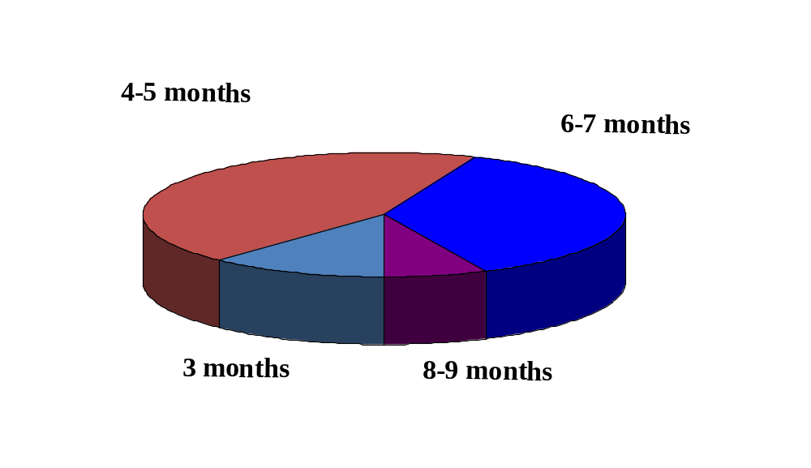
Timing of First Antenatal Visit
44%
37%
12%
7%

Slide 8
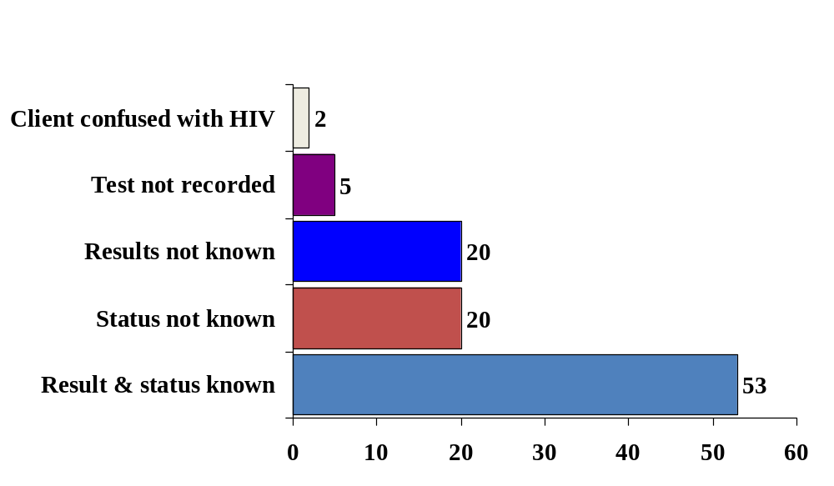
Knowledge of Syphilis Status
Percent of clients

Slide 9
Policy Implications
Pregnant women start ANC late
Pregnant women spend more time and get minimal quality of service
Analysis of blood off-site causes a delay in commencing treatment
Partners are not treated for syphilis

Slide 10
Recommendations
Initiate programmes for motivating women to start ANC in their first 3 months
Provide more resources for syphilis screening and treatment
Review the following:
  Rendering of ANC services
  Partner tracing

Slide 11
SYPHILIS
Causative agent: Treponema Pallidum
Mode of transmission:
  sexual ( most common).
  close contact with open lesions( rare).
  direct blood transfusion.
  cong. Syphilis
Fetal infection is most likely when the mother is in the primary or secondary stages.
After inoculation, the incubation period is around 3 weeks (10-90 days) at the end of which a primary sore develops at the site of infection usually the genitalia.

Slide 12
Classification
Syphilis is classified as:
Congenital
Acquired

Slide 13
Stages
There are four stages:
  Primary
  Secondary
  Latent
  Late Tertiary

Slide 14
Primary
Development of a chancre (painless, solitary round indurated ulcer)at the site of infection
They appear 3 weeks after sexual contact and heal in 3-6 weeks
Some times the ulcer can be at the cervix and therefore go unnoticed by the client or the partner.

Slide 15
Primary Stage
A lymphocytic and plasmocytic infiltrate is a prominent feature of the dermal changes.
There is proliferation of the capillaries and lymphatics.
These vessels also show changes of the endarteritic type.
The larger vessels exhibit proliferation of all their coats and invasion of their walls by the inflammatory infiltrate.

Slide 16
Secondary
Will occur in case patients are untreated in primary stage.
This will be 4-10 weeks after untreated primary stage.
The lesions are numerous, variable and affect many systems. A symmetrically distributed, maculopapular, non-irritating rash is found on the palms and the soles with painless lymphadenopathy.

Slide 17
SECONDARY STAGE
The epidermis may vary from no significant change from normal to the rather marked changes seen in the condyloma latum consisting of acanthosis with broadening and elongation of the rete ridges, intracellular and intercellular edema of the rete cells, and migration of neutrophils through the epidermis. The dermal changes, however, are rather consistent for all of the secondary lesions.

Slide 18
Secondary Stage
The superficial and deep vessels show marked endothelial swelling and are surrounded by a pronounced infiltrate consisting of monocytes, plasma cells, and lymphocytes.
The number of plasma cells in relation to other inflammatory cells is usually high. Treponema pallidum can be identified in the secondary lesions with appropriate stains.

Slide 19
Secondary
Highly infectious condyloma lata are found on warm and moist areas such as genitalia, perianal region, perineum and axillae.
Night headaches and meningism due to confirmed presence of an elevated cell count and elevated proteins in cerebrospinal fluid.

Slide 20
Latent
After untreated secondary syphilis, latent phase occurs that’s marked by spontaneous resolution after 3-12 weeks leaving the patient symptoms free.
It can be early (2 yr from the onset of the infection)or late(more that 2 yr) latent phase
At least 60% of patients remain in latent phase for the rest of their lives.
25% might relapse with a secondary syphilitic manifestation.

Slide 21
Latent stage
The gumma is the hallmark of the lesions of late benign syphilis and a classic example of granulomatous inflammation.
The gumma may occur in any organ or tissue of the body and it should be emphasized that when the lesion occurs in such essential organs as the brain or heart, the condition may well not be "benign."

Slide 22
Latent
The gumma grossly is a firm white lesion which may vary from microscopic size to 10 cm. or more in diameter. Grossly, they may frequently be confused with neoplasms.
Histologically the gumma consists of an area of caseous necrosis surrounded by large numbers of lymphocytes, plasma cells, and vascular proliferation showing a characteristic perivascular infiltrate.

Slide 23
Tertiary
It develops in 30-40% of untreated patients.
The three main manifestations of late syphilis are:
  Cardiovascular
    Occur 15-30 yr after primary syphilis and may occur in any large vessel. Its characterized by an aortitis, aortic incompetence, coronary ostial stenosis (presenting as angina) and aortic medial necrosis causing aortic aneurysm.
  Gummatous
    This is granulomatous locally destructive lesions that usually occur 3-12 yr after inoculation.
Neurosyphilis
  Can present with general paresis, tabes dorsalis, syphilitic meningitis, and meningovascular syphilis. The inoculation period is 5-12 years

Slide 24
SYPHILIS
Effect of Syphilis on Pregnancy:
Abortion: of a dead foetus after the 4th month of pregnancy when the spirochetes can cross the placenta as the cytotrophoblast starts to disappear.
Repeated late abortions eg macerated still born then live born with congenital syphilis or developing it later on.
congenital syphilis:-Skin eruption- osteititis of nasal bones – saddle nose –hepatosplenomegaly-frontal bossing -8th nerve deafness.

Slide 25
Diagnosis
(A) History: of infection, repeated late abortions or macerated still birth.
(B) Examination: Signs of primary, secondary or tertiary syphilis.
(C) Investigations: by serological tests;
  Non- specific (non-treponemal ) tests:
  Venereal disease research laboratory (VDRL).
  Rapid plasma reagin (RPR).
  Specific (treponemal) tests:
  Fluorescent treponemal antibody absorption test (FTA - ABS).
  Treponema pallidum immobilization test (TPI).
  Non-treponemal test can be positive in other conditions as collagen diseases , lymphomas, mononucleosis, and febrile illnesses. So these tests can be performed as screening tests, if positive a specific (treponemal) test is done to confirm or refute syphilis.

Slide 26
Treatment
(A) Mother:
Treatment should be started before 16 weeks i.e. before spirochetes cross the placenta
(I) Penicillin:
Procaine penicillin 600.000 units IM daily for 17 days or - benzathine penicillin (long acting) 2.4 million units IM, half the dose in each buttock. This is repeated for 3 courses at 2 weeks interval.
(II) Erythromycin:
500 mg/ 6 hours orally for 21 days is given to patients who are allergic to penicillin.
(B) New born:
Procaine penicillin 150.000 units IM for 10 days.

